Slide 1
British Airways Customer Review Analysis
A Sentiment Analysis of Customer Feedback
Presenter: OMOLERE, Mojisola Florence
Date: 8th May, 2025

Slide 2
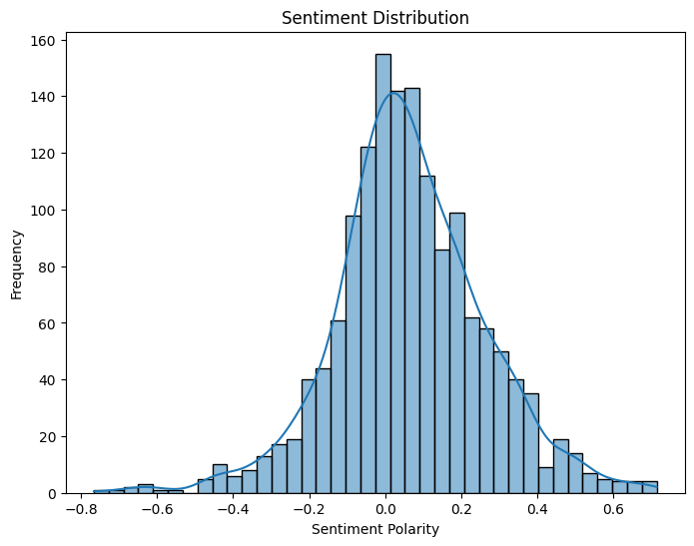
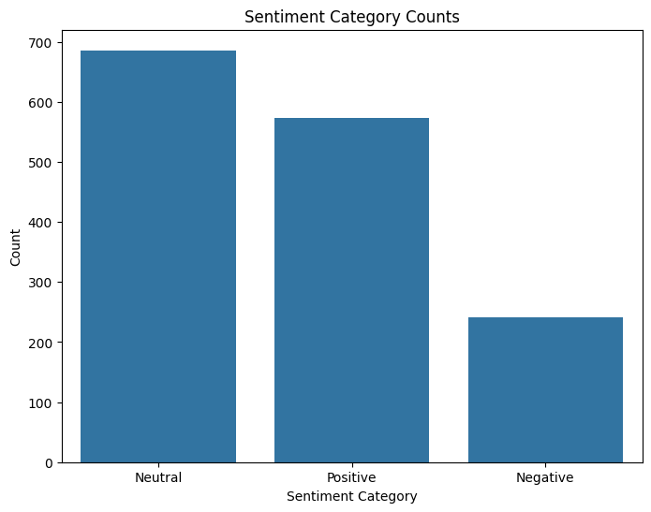
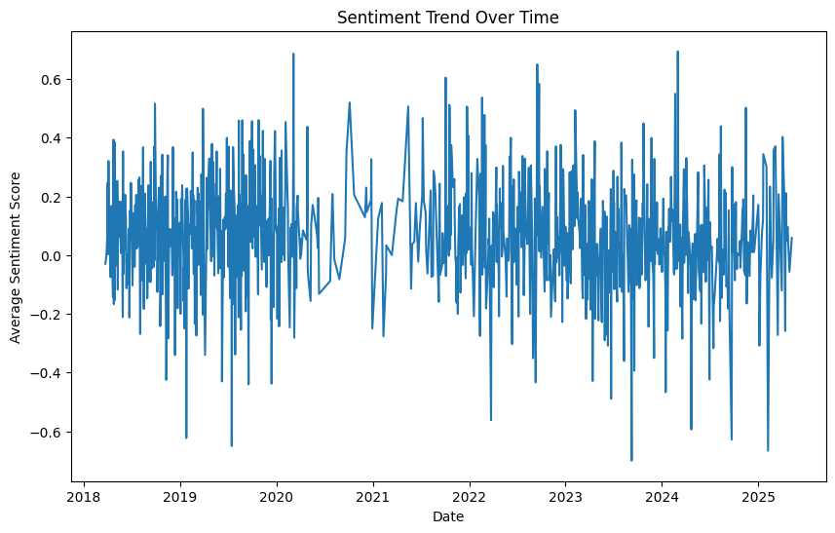
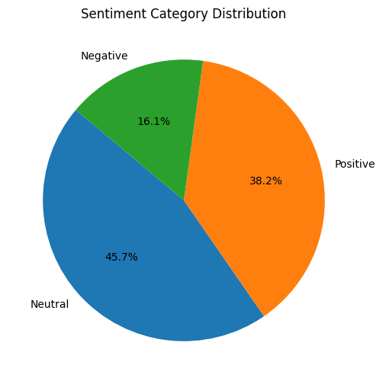
Data Source: AirlineQuality.com Project Goal: To analyze customer sentiment in British Airways reviews and identify key trends.
Visualizations
Conclusion
This analysis provides insights into customer sentiment trends regarding British Airways. The sentiment analysis reveals a mix of positive, negative, and neutral feedback. Further investigation into the specific content of negative reviews may help identify areas for service improvement. The visualizations help to quickly understand the data.
Methodology
Data Collection:
Scraped 1500 British Airways customer reviews from AirlineQuality.com using Python and BeautifulSoup.
Extracted review text and review dates.
Data Cleaning:
Removed irrelevant text (e.g., "Trip Verified") from reviews.
Cleaned and standardized review text.
Handled missing review data.
Feature Engineering:
Calculated review text length (word count and character count).
Sentiment Analysis:
Used TextBlob to determine the sentiment polarity of each review.
Categorized sentiment as Positive, Negative, or Neutral.
Visualization:
Visualized sentiment distribution, category counts, and sentiment trends over time.
Key Findings
Overall Sentiment: The distribution of sentiment in British Airways customer reviews shows a range from positive to negative, with a notable portion of neutral reviews.
Sentiment Trends: Sentiment trends over time can help identify periods of improved or declined customer satisfaction, potentially correlating with operational changes or events.
Text Length Analysis: The distribution of review lengths (word count) indicates that most reviews are of moderate length, with fewer very short or very long reviews.

